Slide 1

Scanning Electron Microscopy
Presented by:
Trevor Jaastad
Josiah Farinacci
Cyrus Harris

Slide 2

Overview
Inner Workings of SEM
Applications of SEM
SEM & Materials Engineering

Slide 3

Part 1: Inner Workings of SEM

Slide 4

What Is Microscopy?
Microscopy is the scientific study of very small structures.
Biology
Materials science
Nanotechnology.
Magnifies
Shorter wavelengths = higher resolution.

Slide 5
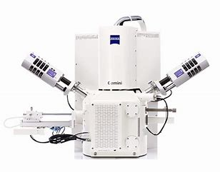
What is Scanning Electron Microscopy
Form of Microscopy
Collects information using electrons
Dehydration
Conductive coating
Specialized equipment

Slide 6
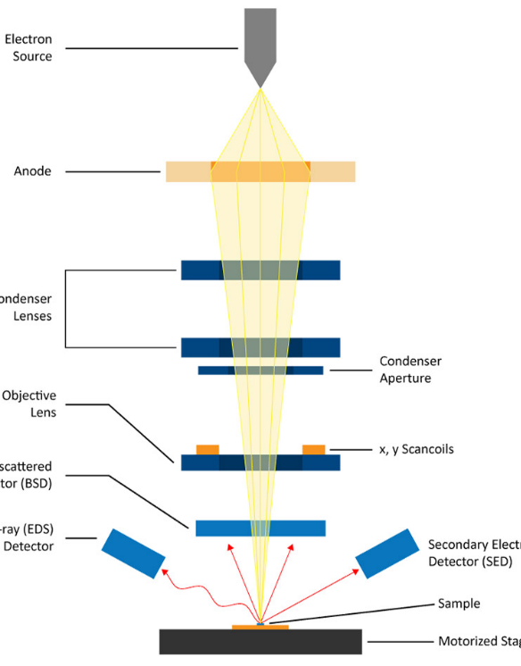
Scanning Electron Microscopy Process
How SEM works
A beam of electrons is directed at a specimen
Resolution determined by beam wavelength
Beam scans sample
Signals create 3D-like images.

Slide 7
Part 2: Applications of SEM

Slide 8
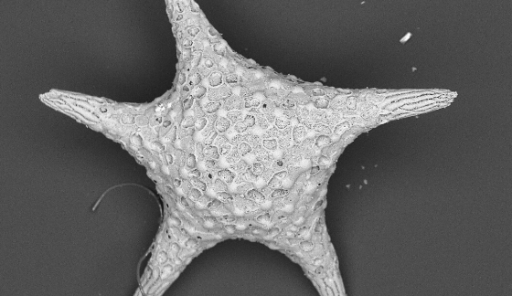
Notes:
Magnification 1 million times.

Slide 9
Data
Applications
Wear-resistant
Corrosion-resistance
Durability
Longevity
Grain Boundaries
Crystal Orientations
Phases
Microstructures
Notes:
Understanding these elements can lead scientists to create stronger, more wear-resistant material useful in the construction, medical, and commercial settings.

Slide 10


Practical Applications

Slide 11

Scanning Electron Microscopy
Image depth of field
Size
High Conductivity
Transmission
Electron
Microscopy
Resolution
Low Conductivity
Notes:
To get a better understanding of SEM, let’s compare it to TEM
Energy Dispersive Spectroscopy (EDS) is a popular microanalytical technique that is used to identify and quantify the elements present in a sample. When working alongside a scanning electron microscope (SEM) or scanning transmission electron microscope (STEM), EDS can be used to create elemental maps of samples.

Slide 12
Part 3: SEM & Materials Engineering

Slide 13
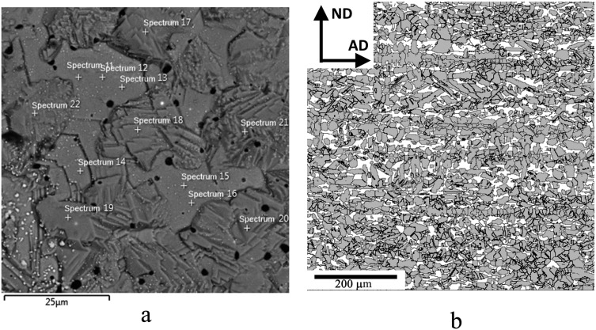
Phase Diagrams
Composition
Ratios (Differences)
Paired With Other Methods (X-Ray)
Notes:
Like we learned in class, every material has a certain combination of phases (whether that be something like alpha and bate or just a plain solid or a liquid). These phases typically expressed themselves differently within the material with one phase forming with a certain structure (say spherical) and another forming in layers. Since SEM can capture the microscopic surface of a structure it can also pick up on this microscopic differences for these different phases (as shown in the picture). With this, SEM can be used to find the ratio of these different phases (again by noticing the difference in the phase structures/composition).
While SEM can be used for this purpose, it is not an extremely reliable method which is why it is typically paired with another method (typically an X-Ray method like EDS). This often gives different results which can improve the rigor and reliability of the research as a whole.

Slide 14
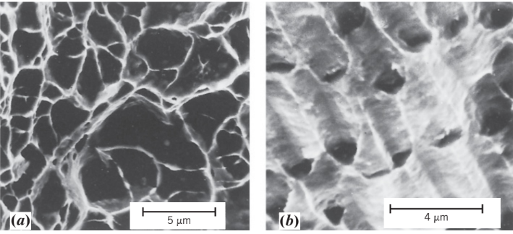
Failure Analysis
Fractography
Skills – Depth Perception
Helps develop other relations – Material Properties
Notes:
While SEM can be used to determine phases, its main function in Materials Engineering is frahk-tog-ruh-fee. Frac-tog–graphy is actually a special name for SEM when it is used within the realm of Failure analysis.
The reason why SEM is a preferred method when analyzing the failure within a matieral is because of the amount of resolution that SEM can offer (since it is method that uses electrons) and it also has a very good sense of depth. This depth perception is especially important. With it we could see how different cracks are really propagating or just how a material is deforming. One image that we talked about in class before where SEM was used was in the context of void nucleation in steel. SEM was able to visualize these voids that were occurring with a striking amount of detail.
Along with this, SEM has also been known to help aid in the research of material properties. So, things like elasticity modulus, brittleness, tensile strength, etc. but since this method primarily just gives a good image you would obviously need other specialized techniques and data that could actually give values for these different variables.
Within different studies, SEM is probably just used to display what is visually occurring when a certain material is loaded or under some other sort of stress. This type of image could potentially help confirm or display how the material was expected to behave given the calculated properties.

Slide 15
Conclusion
Inner Workings of SEM
Applications of SEM
SEM & Materials Engineering

Slide 16

Questions and Answers

